Slide 1

Compass for Parents

Slide 2

Logging in
Log in Using your unique parent code and Temporary password sent to you by your school.
You will be prompted to set a new password on your first log in.
If you have 10 failed attempts to log in you will be locked out for 30 minutes.
You can always use the ‘Cant Access Your Account’ option to reset your Password.

Slide 3
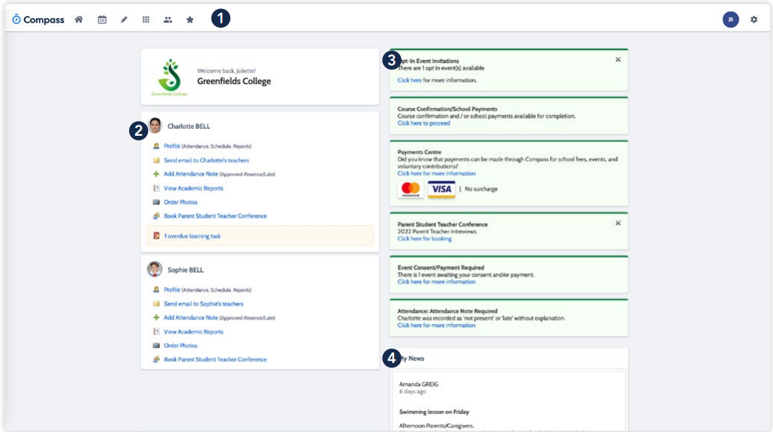
Compass Homepage
When you First login you will be taken to the Homepage.
From here you can see and access all areas of Compass.
Menu Options – Access events, Calendar, etc.
Child Information – Student Profile, Semester Reports, absence notes
Alerts – Unexplained absences, events requiring approval
Newsfeed – Your school’s way of communicating through Compass

Slide 4
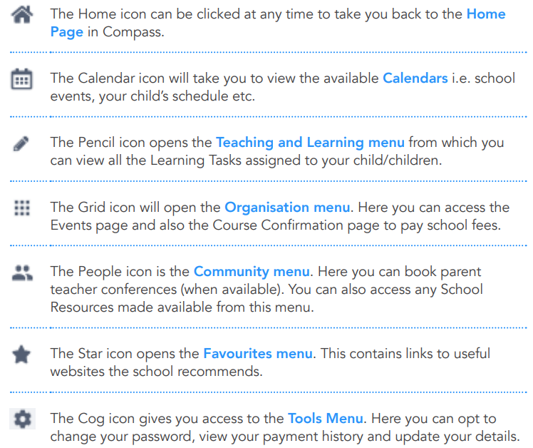
Menu Icons

Slide 5
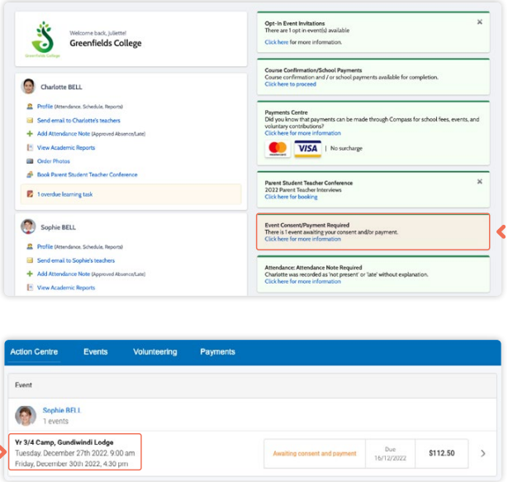
Consent to an Event
If your child has an upcoming event that requires your consent and/or payment, you will see an alert on your homescreen. Click the alert and it will take you to the Events page (alternatively you can click the grid menu icon at the top of the screen and select ‘Events’).
On the ‘Action Centre’ tab you will see any events requiring your action. If you have more than one student at the school, events will be listed here under each child. Click the event you wish to action.

Slide 6
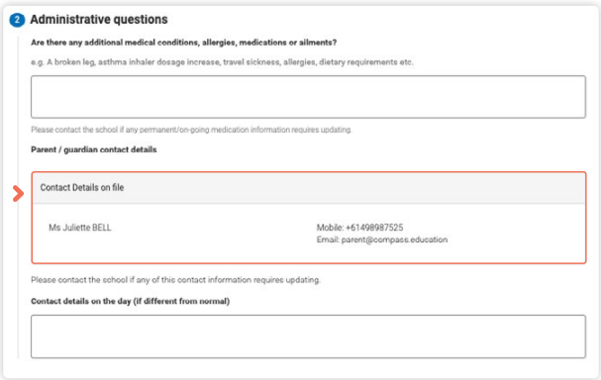
Consent to an Event (Continued)
Follow all on screen prompts to Consent to the event. Including reviewing your child's medical information if required.
When you reach the administrative questions if no changes are required, please leave these fields blank.
Your school's office team will be notified if anything is added to these fields.

Slide 7
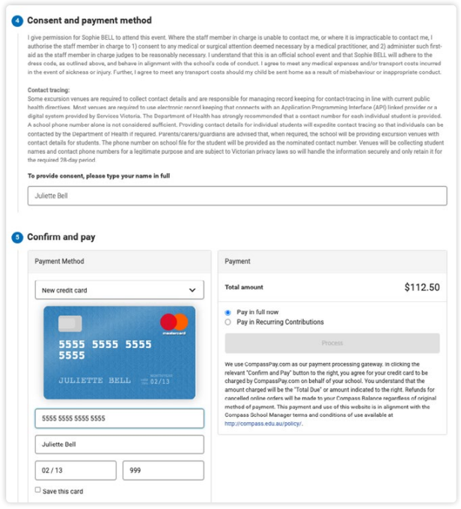
Consent to an Event (Continued)
The final step is Consent and Payment (If required)
To Consent type your full name and select your preferred payment option if required.
It is important to remember if your schools has set up payments plans, and you wish the select this as your preferred form of payment. You are unable to adjust the payment amounts or dates.

Slide 8
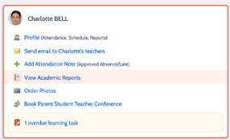
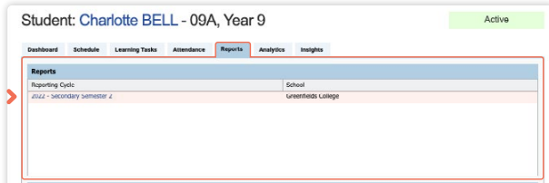
Accessing your Childs reports
To view your child’s report, click the option under their details on your dashboard.
This will take you to the ‘Reports’ tab of your child’s profile. Here you will see any available reports listed.
Click the blue title of the specific report you want to access and it will download as a pdf file to your device for viewing.

Slide 9

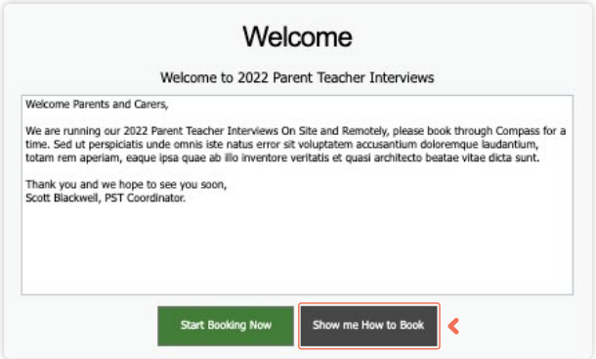
Booking Parent Teacher Conferneces
When a parent teacher conference cycle becomes available, an alert will appear on your dashboard prompting you to make a booking. Click the alert
This will take you to the conference cycle and you will see the Welcome message from the school that will include details about the conference.
Click the ‘Show me how to book’ option for guided instructions on how to secure your conference booking.

Slide 10
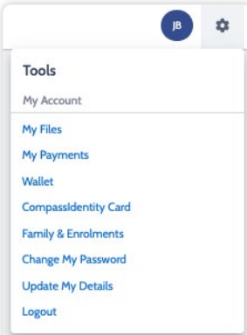
Updating Passwords and Details
Password-
If you need to change your password, go to the cog icon and select ‘Change my Password’. Key in the required information ensuring your new password meets the set guidelines. Click ‘Save’ to update.
Details-
If you need to update the mobile number or email address on file for your account, go to the cog menu icon and select ‘Update my Details’. Add in your new contact information. This will trigger a notification to the school advising them of these changes

Slide 11
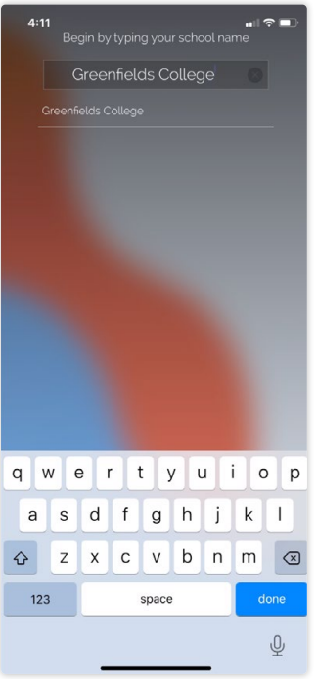

Compass Mobile App
You can use the Compass app to action tasks. The app is available to download for free from the Apple App Store or the Google Play store.
Once installed and opened for the first time, you will be prompted to choose which school your child attends.
After selecting the school, you will be required to enter your log in details which are the same details you use to log in to your Compass parent portal.

Slide 12
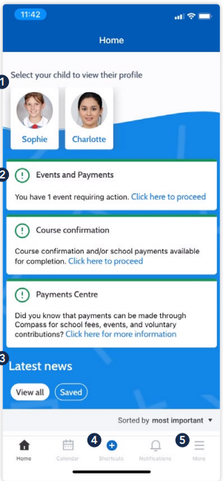
Compass Mobile App (Continued)
When logged in, you will see:
Profiles Each of your children who attend the school will appear at the top of the screen. Click their image to go to their profiles. Within the profile you can access information pertaining to your child such as their schedule, learning tasks, attendance approvals and reports.
Alerts Notifications of items that require your action.
Newsfeed Scroll through to view the latest posts from your school.
Shortcuts The shortcuts button allows you to perform quick actions such as adding an attendance note or paying for an event.
More Gives you access to additional actions

Slide 13
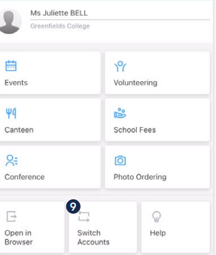
Compass Mobile App (Continued)
Events Consent/payment Process consent/payment for your child’s upcoming events.
Conferences Allows you to book teacher conferences.
Switch Accounts If you have children attending different schools that use Compass (i.e. a child in Primary School and a child in Secondary School), you can use the ‘Switch Accounts’ option at the bottom of the menu to toggle between your parent account at each Compass school

Slide 14
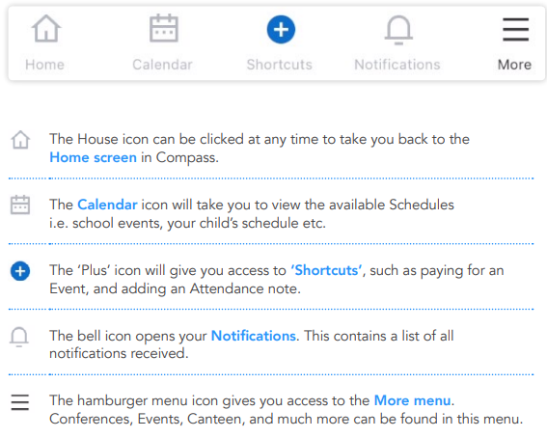
Compass Mobile App (Continued)

Slide 15
Compass Parent Guide
Use the QR code to access Compasses online Parent Guide.
Reminder CECG is not using all features in Compass currently

